Slide 1
HW3
Xinyi Xu
Ziyue Qin

Slide 2

Clustering
A N( mu, SIGMA) in a rotating plot in 3D
import numpy as np
import plotly.graph_objects as go
# 定义参数
mu = 0
sigma = 1
x = np.linspace(mu - 3*sigma, mu + 3*sigma, 50)
y = np.linspace(mu - 3*sigma, mu + 3*sigma, 50)
X, Y = np.meshgrid(x, y)
Z = np.exp(-( (X-mu)**2 + (Y-mu)**2 )/(2*sigma**2)) / (2*np.pi*sigma**2)
# 创建3D曲面图
fig = go.Figure(data=[go.Surface(x=X, y=Y, z=Z, colorscale='Viridis')])
fig.update_layout(
title='3D Rotatable Normal Distribution',
scene=dict(
xaxis_title='X',
yaxis_title='Y',
zaxis_title='Z'
),
width=800,
height=600
)
fig.show() # 可自由旋转查看
Notes:
20161215 Shanghai C YH Chen, W K Härdle
45 min a crash course in R from BCS slides, see LvB Metis (CC)
30 min Quantlet introduction
45 min CRIX (WKH)
45 min Econometrics of CRIX (CC)
60 min SDA Text Scraping + Classification (CC)
45 min SDA SVM (WKH)
60 min Distillation of news flows + sector specific sentiments (CC)
45 min SDA Dynamic Topic Modelling (WKH)
45 min SDA applications (WKH+CC)
45 min TEDAS TED Asset Allocation (WKH)
45 min Tail Event driven Network AR

Slide 3
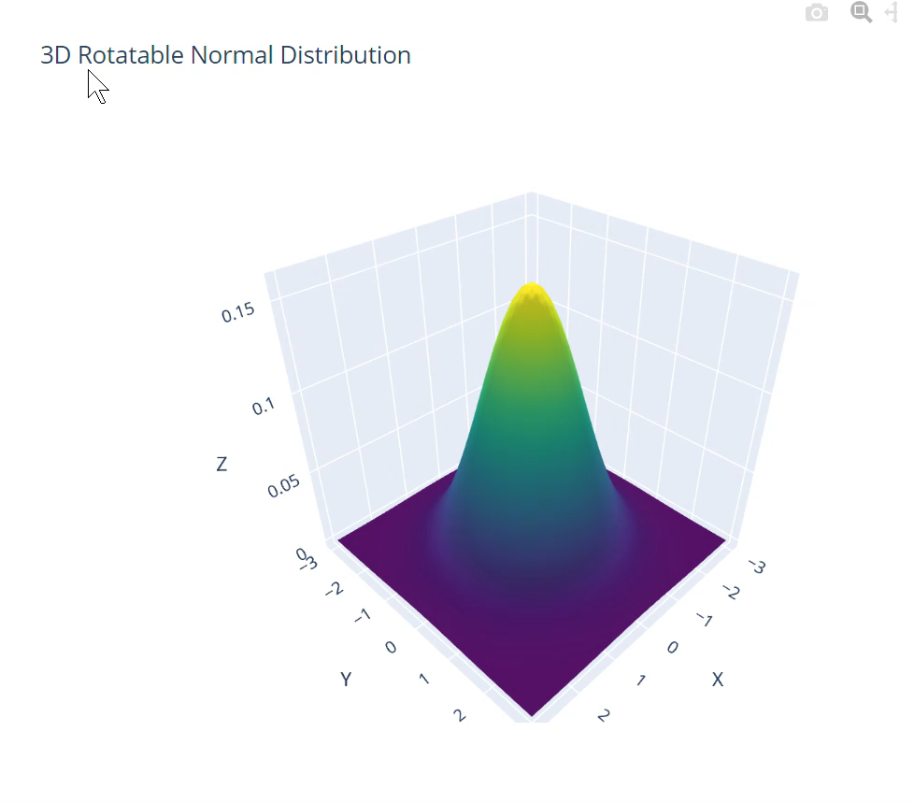
Clustering
3D Rotatable Normal Distribution
Notes:
20161215 Shanghai C YH Chen, W K Härdle
45 min a crash course in R from BCS slides, see LvB Metis (CC)
30 min Quantlet introduction
45 min CRIX (WKH)
45 min Econometrics of CRIX (CC)
60 min SDA Text Scraping + Classification (CC)
45 min SDA SVM (WKH)
60 min Distillation of news flows + sector specific sentiments (CC)
45 min SDA Dynamic Topic Modelling (WKH)
45 min SDA applications (WKH+CC)
45 min TEDAS TED Asset Allocation (WKH)
45 min Tail Event driven Network AR

Slide 4
Clustering
Redo the LDA example IRTG 1792
# -*- coding: utf-8 -*- import os import re import requests from bs4 import BeautifulSoup as soup import nltk import numpy as np import pandas as pd import matplotlib.pyplot as plt import string from nltk.stem.wordnet import WordNetLemmatizer from nltk.corpus import stopwords import gensim from gensim import corpora # 确保 nltk 资源可用 nltk.download('punkt') nltk.download('stopwords') nltk.download('wordnet') # ================================ # 抓取 Abstracts # ================================ base_link = 'http://www.wiwi.hu-berlin.de/de/forschung/irtg/results/discussion-papers' request_result = requests.get(base_link, headers={'Connection': 'close'}) parsed = soup(request_result.content, 'html.parser') tr_items = parsed.find_all('tr') info_list = [] for item in tr_items: link_list = item.find_all('td') try: paper_title = re.sub(r'\s+', ' ', link_list[1].text.strip()) author = link_list[2].text date_of_issue = link_list[3].text abstract_link = link_list[5].find('a')['href'] info_list.append([paper_title, author, date_of_issue, abstract_link]) except: continue
abstract_all = [] for paper in info_list: try: paper_abstract_page = requests.get(paper[3], headers={'Connection': 'close'}) if paper_abstract_page.status_code == 200: abstract_parsed = soup(paper_abstract_page.content, 'html.parser') main_part = abstract_parsed.find_all('div', attrs={'id': 'content-core'})[0].text.strip() main_part = re.sub(r'.+?[Aa]bstract', 'Abstract', main_part) main_part = re.sub(r'JEL [Cc]lassification:.*', '', main_part) main_part = re.sub(r'[A-Za-z][0-9][0-9]?', '', main_part) main_part = re.sub('[\r\n]+', ' ', main_part) abstract_all.append(main_part + "\nSEP\n") except: continue with open('Abstract_all.txt', 'w', encoding='utf-8') as f: f.writelines(abstract_all) # ================================ # LDA 分析 # ================================ K = 7 # number of topics text_pre = open('Abstract_all.txt', encoding="utf8").read() doc_l = str.split(text_pre, sep='SEP') # 文本清理 stop = set(stopwords.words('english')).union({ 'result','keywords','study','using','paper','abstract','f','x','e','topic','proposed','one' }) exclude = set(string.punctuation) lemma = WordNetLemmatizer() def clean(doc): stop_free = " ".join([i for i in doc.lower().split() if i not in stop]) punc_free = ''.join(ch for ch in stop_free if ch not in exclude) normalized = " ".join(lemma.lemmatize(word) for word in punc_free.split()) return normalized doc_clean = [clean(doc).split() for doc in doc_l] # LDA dictionary = corpora.Dictionary(doc_clean) doc_term_matrix = [dictionary.doc2bow(doc) for doc in doc_clean] Lda = gensim.models.ldamodel.LdaModel ldamodel = Lda(doc_term_matrix, num_topics=K, id2word=dictionary,
passes=50, random_state=42) topicWordProbMat = ldamodel.print_topics(K)
Notes:
20161215 Shanghai C YH Chen, W K Härdle
45 min a crash course in R from BCS slides, see LvB Metis (CC)
30 min Quantlet introduction
45 min CRIX (WKH)
45 min Econometrics of CRIX (CC)
60 min SDA Text Scraping + Classification (CC)
45 min SDA SVM (WKH)
60 min Distillation of news flows + sector specific sentiments (CC)
45 min SDA Dynamic Topic Modelling (WKH)
45 min SDA applications (WKH+CC)
45 min TEDAS TED Asset Allocation (WKH)
45 min Tail Event driven Network AR

Slide 5
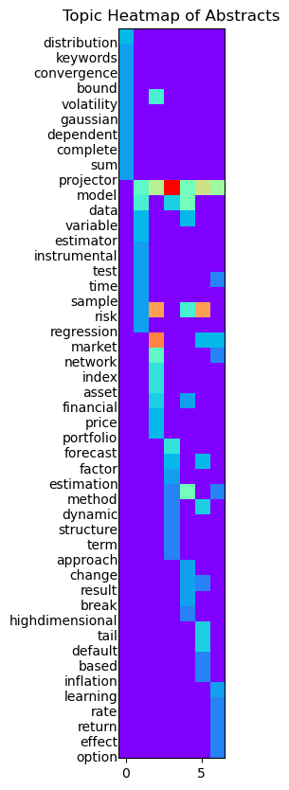
# ================================ # 热力图可视化 # ================================ columns = [f'Topics {x+1}' for x in range(K)] df = pd.DataFrame(columns=columns) zz = np.zeros(shape=(100,K)) last_number=0 DC={} # 填充 DataFrame for line in topicWordProbMat: tp, w = line probs = w.split("+") y = 0 for pr in probs: a = pr.split("*") word = a[1].strip().replace('"','') df.loc[y, columns[tp]] = word if word in DC: zz[DC[word]][tp] = float(a[0]) else: zz[last_number][tp] = float(a[0]) DC[word] = last_number last_number +=1 y +=1 zz = np.resize(zz, (len(DC.keys()), zz.shape[1])) plt.figure(figsize=(16,10)) for val, key in enumerate(DC.keys()): plt.text(-0.5, val + 0.5, key, ha='right', va='center') plt.imshow(zz, cmap='rainbow', interpolation='nearest') plt.yticks([]) plt.title("Topic Heatmap of Abstracts") plt.savefig("heatmap_abstract.png", dpi=300, bbox_inches='tight') plt.show()

